Slide 1
ANDROID PERMISSIONS Part 1

Slide 2

INTRODUCTION
In an attempt to maintain security (system integrity, user privacy) on Android, devices run each app in a limited sandbox .
Android's app permissions build upon a central design point of the Android security architecture.
By default, no app has permission to perform any operations that would adversely impact other apps, the operating system, or the user.
If app wants to use resources (e.g. camera, storage, network) or information (e.g. contacts info) outside of sandbox, must request permission.
Notes:
Sandbox: A sandbox is an isolated testing environment that enables users to run programs or open files without affecting the application, system or platform on which they run.

Slide 3
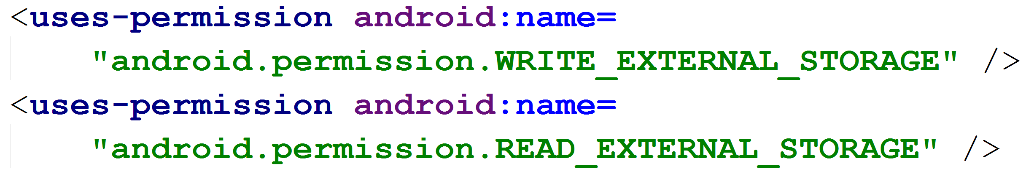
HISTORY OF PERMISSIONS
Prior to Android version 6.0, Marshmallow (API 23)
Apps requested permission at install time (during installing the app from app store)
Permissions were Listed in the AndroidManifest.xml File

Slide 4
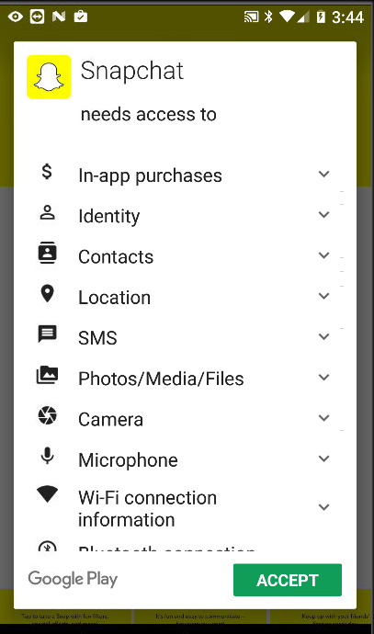
Install Time Permissions
Pre 6.0 / Marshmallow user granted permission at install time.
Google Play listed permissions for app when install was selected

Slide 5
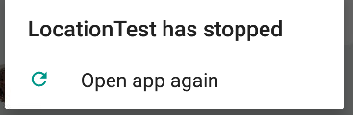
Lacks Permissions (Install time)
App stopped by system as soon as it tries to perform operation it doesn’t have permission for…
Exception: 02-09 16:03:39.857 26846-26846/org.example.locationtest E/AndroidRuntime: FATAL EXCEPTION: main Process: org.example.locationtest, PID: 26846 java.lang.RuntimeException: Unable to start activity ComponentInfo {org.example.locationtest/org.example.locationtest.LocationTest}: java.lang.SecurityException: "passive" location provider requires ACCESS_FINE_LOCATION permission. at android.location.LocationManager.getProvider(LocationManager.java:383) at org.example.locationtest.LocationTest.dumpProvider(LocationTest.java:372) at org.example.locationtest.LocationTest.dumpProviders(LocationTest.java:364) at org.example.locationtest.LocationTest.onCreate(LocationTest.java:80)

Slide 6
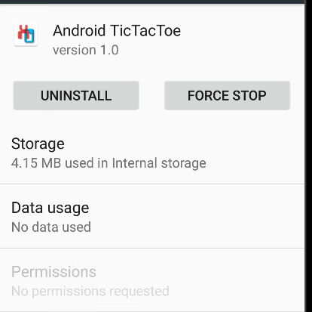
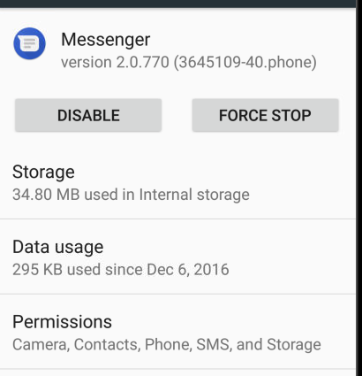

VIEWING PERMISSIONS
A user can see what permissions an app has in Settings -> Apps
Developers can see device permissions via command line:

Slide 7
Changes to Permissions
Android 6.0 / Marshmallow introduced changes to permissions
Types of Permissions
PERMISSIONS
Install time (Pre Version 6)
Normal Permissions
Dangerous/Runtime Permissions
Permission Groups

Slide 8
Normal Permissions
Normal Permissions: These permissions allow access to data and actions that extend beyond your app's sandbox. However, the data and actions present very little risk to the user's privacy, and the operation of other apps. They fall under Install time Permissions.
• ACCESS_LOCATION_EXTRA_COMMANDS • ACCESS_NETWORK_STATE • ACCESS_NOTIFICATION_POLICY • ACCESS_WIFI_STATE • BLUETOOTH • BLUETOOTH_ADMIN • BROADCAST_STICKY • CHANGE_NETWORK_STATE • CHANGE_WIFI_MULTICAST_STATE • CHANGE_WIFI_STATE • DISABLE_KEYGUARD • EXPAND_STATUS_BAR • GET_PACKAGE_SIZE • INSTALL_SHORTCUT • INTERNET • KILL_BACKGROUND_PROCESSES • MODIFY_AUDIO_SETTINGS • NFC
• READ_SYNC_SETTINGS • READ_SYNC_STATS • RECEIVE_BOOT_COMPLETED • REORDER_TASKS • REQUEST_IGNORE_BATTERY_OPTIMIZAT IONS • REQUEST_INSTALL_PACKAGES • SET_ALARM • SET_TIME_ZONE • SET_WALLPAPER • SET_WALLPAPER_HINTS • TRANSMIT_IR • UNINSTALL_SHORTCUT • USE_FINGERPRINT • VIBRATE • WAKE_LOCK • WRITE_SYNC_SETTINGS

Slide 9
Dangerous/Runtime Permissions
Dangerous/Runtime Permissions: Runtime permissions, also known as dangerous permissions, give your app additional access to restricted data, and they allow your app to perform restricted actions that more substantially affect the system and other apps. Therefore, you need to request runtime permissions in your app before you can access the restricted data or perform restricted actions.
Dangerous Permissions are listed below: • CALENDAR: READ_CALENDAR, WRITE_CALENDAR • CAMERA: CAMERA • CONTACTS: READ_CONTACTS, WRITE_CONTACTS, GET_ACCOUNTS • LOCATION: ACCESS_FINE_LOCATION, ACCESS_COARSE_LOCATION • MICROPHONE: RECORD_AUDIO • PHONE: READ_PHONE_STATE, CALL_PHONE, READ_CALL_LOG, WRITE_CALL_LOG, ADD_VOICEMAIL, USE_SIP PROCESS_OUTGOING_CALLS • SENSORS: BODY_SENSORS • SMS: SEND_SMS, RECEIVE_SMS, READ_SMS, RECEIVE_WAP_PUSH, RECEIVE_MMS • STORAGE: READ_EXTERNAL_STORAGE, WRITE_EXTERNAL_STORAGE

Slide 10
Permissions Groups
If several permissions relate to a similar capability or feature of an app or device, the system might represent these permissions as a permissions group.
These permission groups help the system minimize the number of system dialogs that are presented to the user when an app requests closely-related permissions.
Dangerous Permissions Organized into Permission Groups: • CALENDAR: READ_CALENDAR, WRITE_CALENDAR • CONTACTS: READ_CONTACTS, WRITE_CONTACTS, GET_ACCOUNTS • LOCATION: ACCESS_FINE_LOCATION, ACCESS_COARSE_LOCATION • PHONE: READ_PHONE_STATE, CALL_PHONE, READ_CALL_LOG, WRITE_CALL_LOG, ADD_VOICEMAIL, USE_SIP, PROCESS_OUTGOING_CALLS • SMS: SEND_SMS, RECEIVE_SMS, READ_SMS, RECEIVE_WAP_PUSH, RECEIVE_MMS • STORAGE: READ_EXTERNAL_STORAGE, WRITE_EXTERNAL_STORAGE

Slide 11
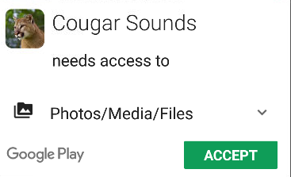
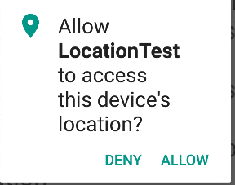
Permissions Post Android 6.0
Post Android 6.0 / Marshmallow all Normal and Dangerous Permissions still placed in app Manifest
If Device is Android 5.1 or lower OR app targets API level 22 or lower then • User must grant Dangerous Permissions at install time • Or app doesn’t install
If device is Android 6.0 or higher AND app targets API level 23 or higher then • Must still list all permissions in manifest • App must request each dangerous permission in needs while the app is running

Slide 12
ANDROID PERMISSIONS Part 2

Slide 13
Requesting Permissions
Requesting permission can be done in two ways.
Requesting Permission by yourself: Traditional Approach
Requesting Permission by System: Recommended Approach

Slide 14
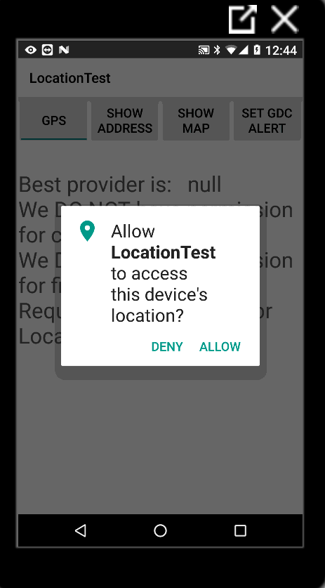
Requesting Permissions: General format
When app needs dangerous permission
Check to see if you already have permission
If not call one of the requestPermission methods with desired permissions and request code
requestPermission shows a standard, non modifiable dialog box to the user

Slide 15
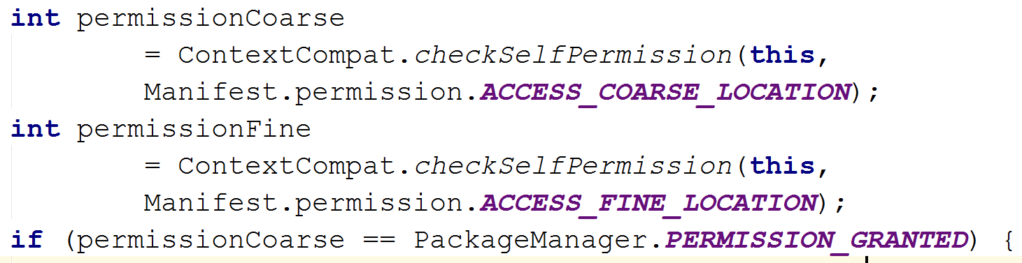
Requesting Permissions: By yourself
Checking Permissions: Before Requesting a Permission, check to see if you already have it.
To check if the user has already granted your app a particular permission, pass that permission into the ContextCompat.checkSelfPermission() method. This method returns either PERMISSION_GRANTED or PERMISSION_DENIED, depending on whether your app has the permission.
Requested Permission

Slide 16
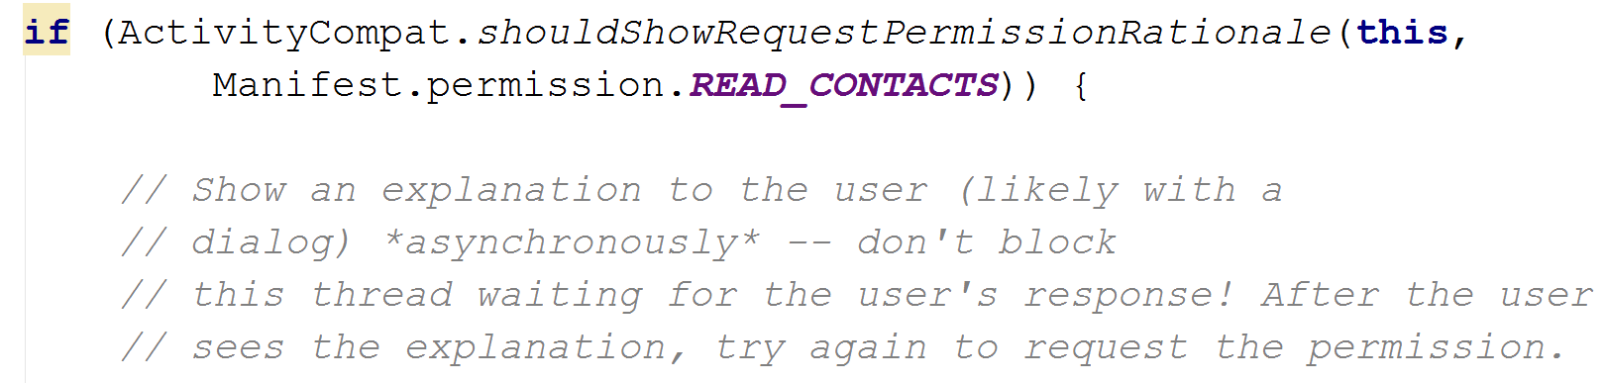
Requesting Permissions: By yourself
Explain why your app needs permission: If the ContextCompat.checkSelfPermission() method returns PERMISSION_DENIED, call shouldShowRequestPermissionRationale().
If this method returns true, show an educational UI to the user. In this UI, describe why the feature, which the user wants to enable, needs a particular permission.
shouldShowRequestPermissionRationale returns true if the app previously requested the permission and the user denied it

Slide 17
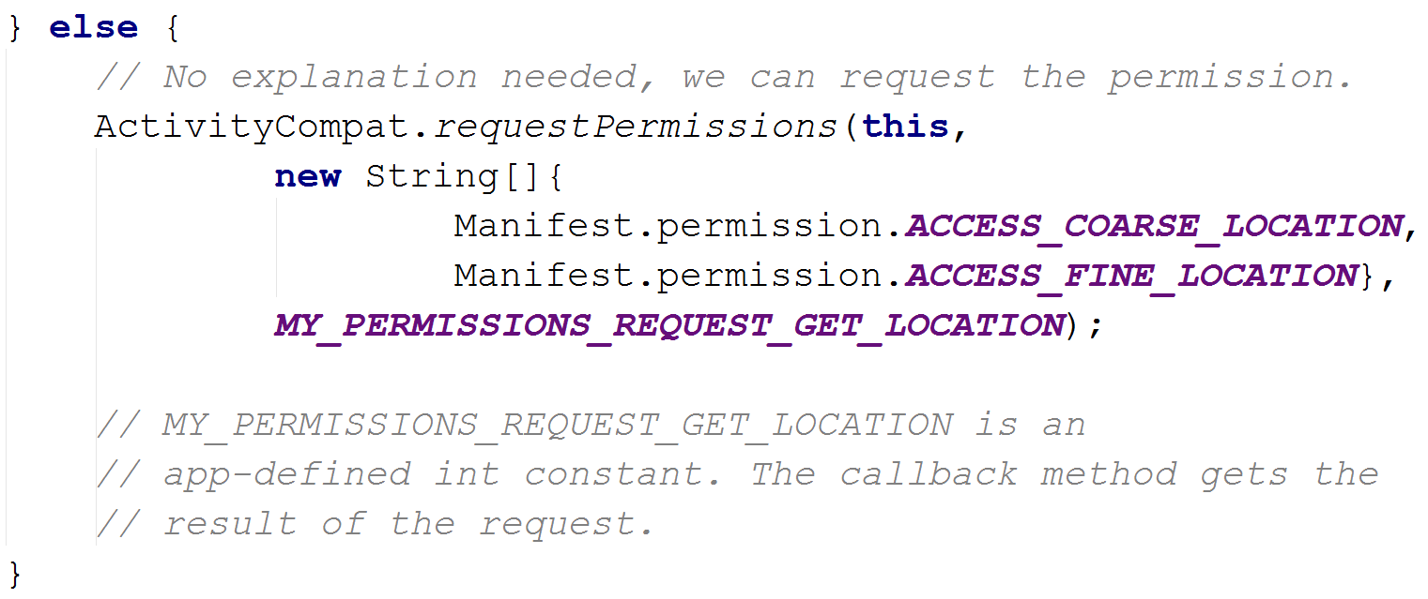
Requesting Permissions: By yourself
Requesting permission: If user has not previously denied permission then request the permission. Users see a system permission dialog, where they can choose whether to grant a particular permission to your app.
Requested Code

Slide 18
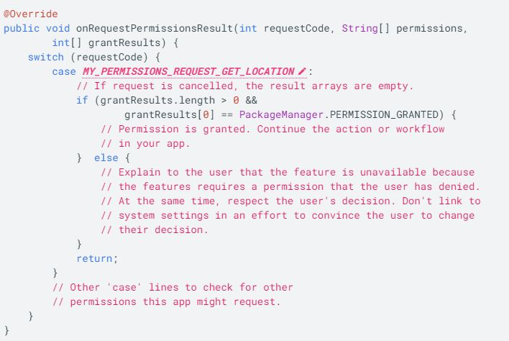
Requesting Permissions: By yourself
Dialog box: Dialog displayed to user. Lists permission group, not individual permissions.
After the user responds to the system permissions dialog, the system then invokes your app's implementation of onRequestPermissionsResult().
The system passes in the user response to the permission dialog, as well as the request code that you defined.

Slide 19
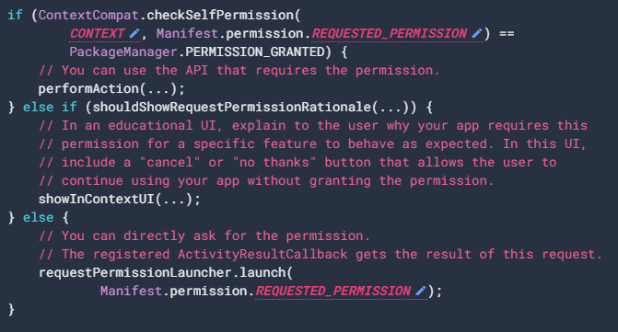
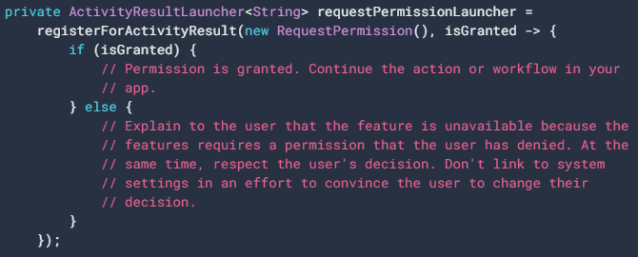
Requesting Permissions: By System
To allow the system to manage the request code that's associated with a permissions request, add a dependency on the androidx.activity library in your module's build.gradle file.
Here the System controls the response of the user through the registerForActivityResult() instead of the onRequestPermissionsResult().

Slide 20
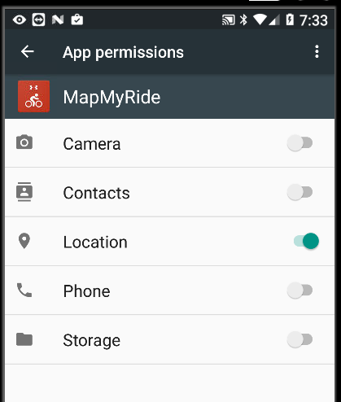
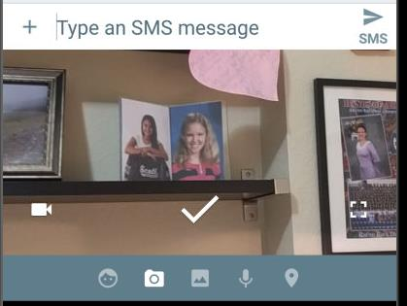
App Permissions Notes
If you use an intent to accomplish something, then your app does not usually have to request permission
For example, if you use an Intent to take picture, you DO NOT need CAMERA permission. • Only if you want to access camera directly in your app. • Example, messenger ->
A user can also alter permissions in the Settings app • Settings -> app • Toggle Switches to grant and deny permissions

Slide 21
App Permissions Best Practices
Only use the permissions necessary for your app to work. Depending on how you are using the permissions, there may be another way to do what you need (system intents, identifiers, backgrounding for phone calls) without relying on access to sensitive information.
Pay attention to permissions required by libraries. When you include a library, you also inherit its permission requirements. You should be aware of what you're including, the permissions they require, and what those permissions are used for.
Be transparent. When you make a permissions request, be clear about what you’re accessing, and why, so users can make informed decisions..
Make system accesses explicit. Providing continuous indications when you access sensitive capabilities (for example, the camera or microphone) makes it clear to users when you’re collecting data and avoids the perception that you're collecting data surreptitiously.
https://developer.android.com/training/permissions/usage-notes: Alternatives for App Permissions

Slide 22
THANK YOU

